Slide 1
SmartStock Inventory Optimization for Retail Stores

Slide 2
agenda
INTRODUCTION 3
LOGIN PAGE 4
DASHBOARD 6
PRODUCTS 8
PREDICTIONS 10

Slide 3

LOGIN PAGE
CONFIDENCE-BUILDING STRATEGIES

Slide 4

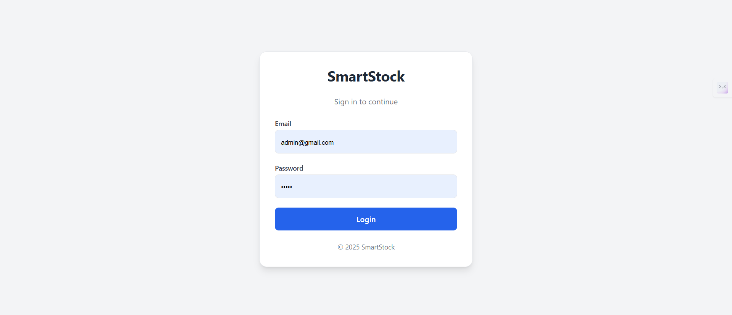
the power of communication

Slide 5

DASHBOARD

Slide 6
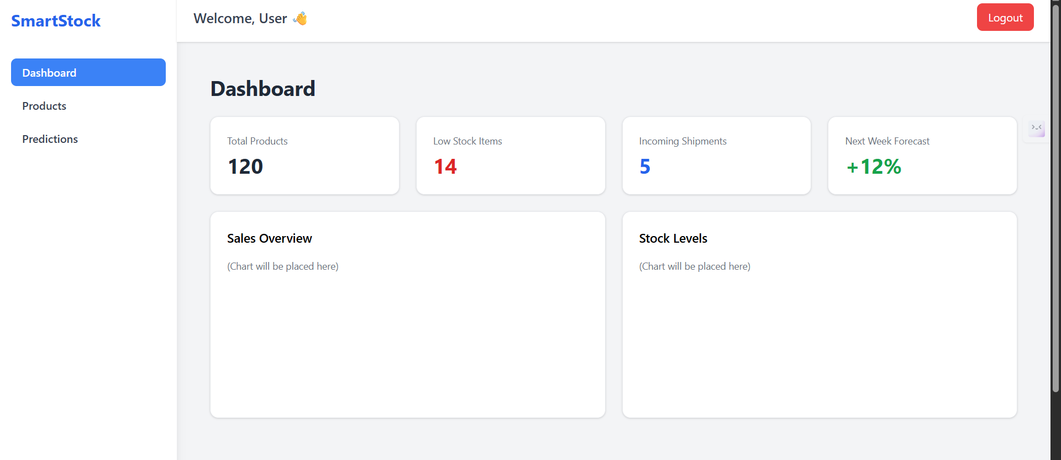

Slide 7
PRODUCTS
CONFIDENCE-BUILDING STRATEGIES

Slide 8
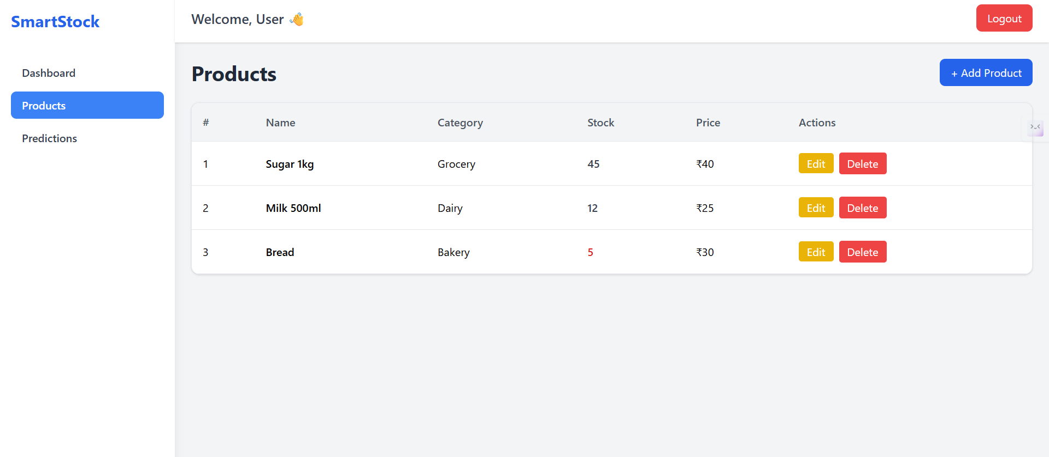
ENHANCING YOUR PRESENTATION

Slide 9
PREDICTIONS

Slide 10
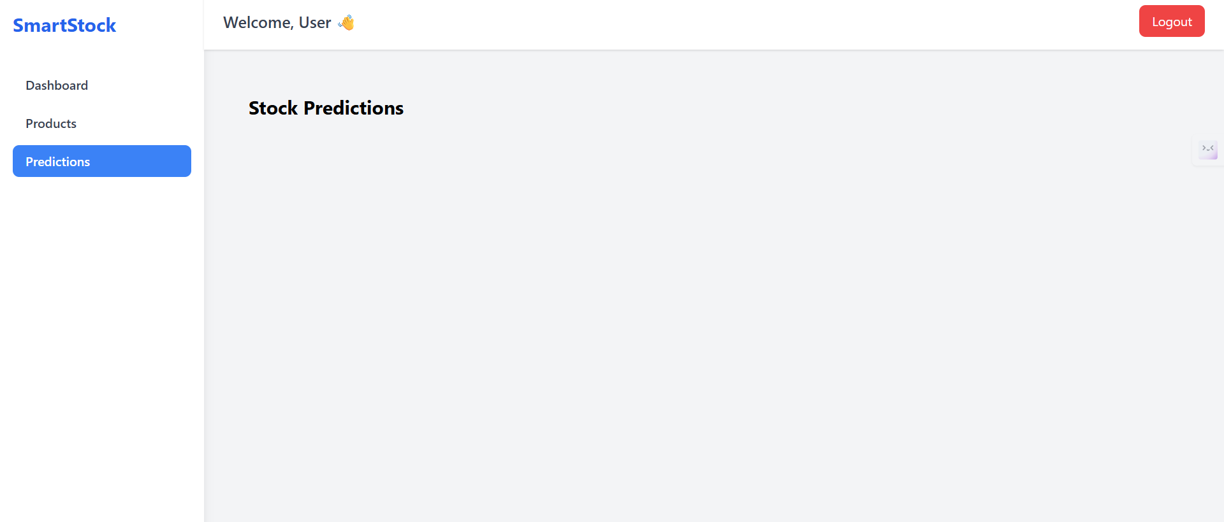
ENHANCING YOUR PRESENTATION

Slide 11
thank you
BRITA TAMM
502-555-0152
  brita@firstupconsultants.com
  www.firstupconsultants.com

